Slide 1

Greater Phoenix
Housing Market Now
by Mike Orr
Director, Center for Real Estate Theory & Practice
W. P. Carey School of Business

Slide 2
The Market Cycle
Euphoria
Unease
Exhilaration
Denial
Enthusiasm
Enthusiasm
Pessimism
Optimism
Optimism
Panic
Relief
Hope
Capitulation
Skepticism
Despair

Slide 3
The Market Cycle
2005
2007
Euphoria
Unease
Exhilaration
Denial
Enthusiasm
Enthusiasm
Pessimism
Optimism
Optimism
2015
2003
Panic
Relief
Hope
2012
Capitulation
Skepticism
2008
Despair
2010

Slide 4
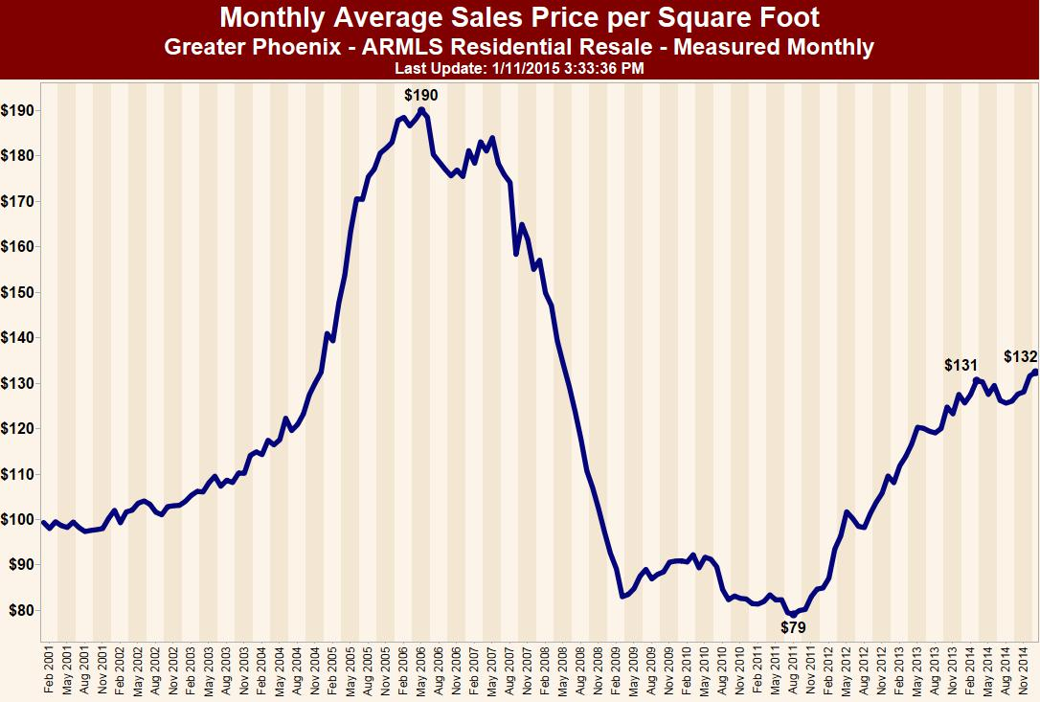

Slide 5
$134
normal inflation (CPI)

Slide 6
Another +44% to reach the peak!
+67%
Nov 2004
May 2008

Slide 7
Only Florida and Nevada
are further from their peak
Another +44% to reach the peak!
+67%
Nov 2004
May 2008

Slide 8
what and where
technology
  Smart Homes emerge – technological disruption and consumer demand for connected places important
  Technology pushing change in space use
  E-commerce and crowdfunding being viewed as an adaptation challenge
    “Omnichannel distribution" and “e-tailers” to open brick-and-mortar stores – changes where and how we do things
Most home prices are flat or keeping pace with 1.5% inflation.
Some segments are falling or rising, but not by much.

Slide 9
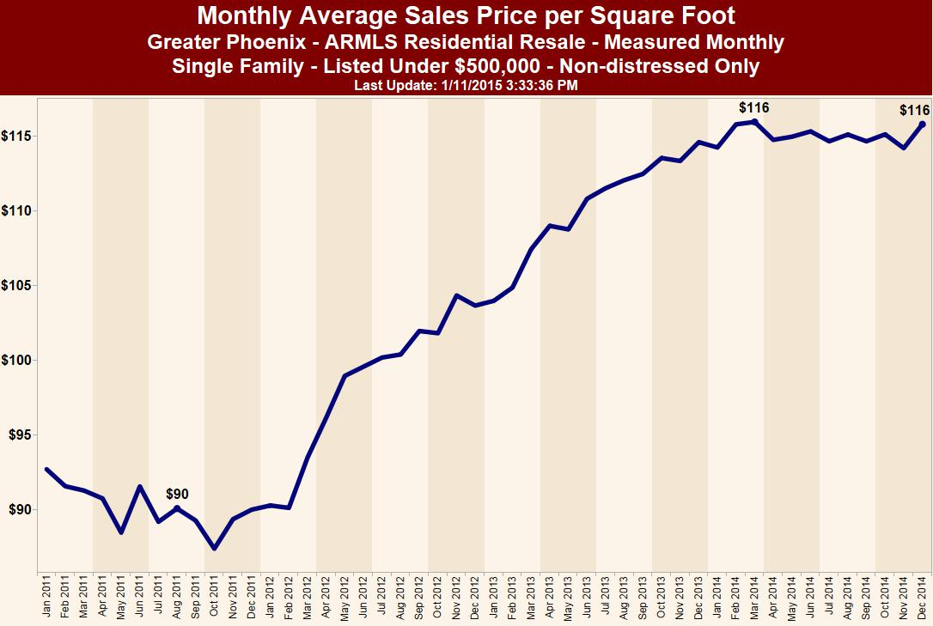

Slide 10
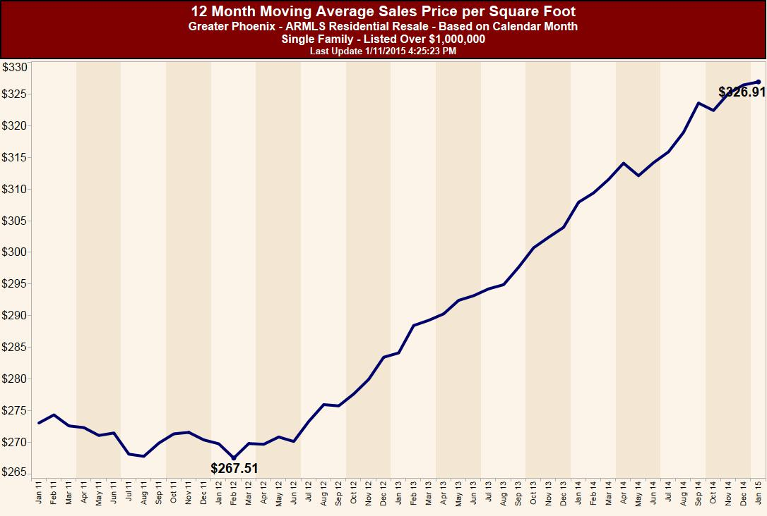

Slide 11
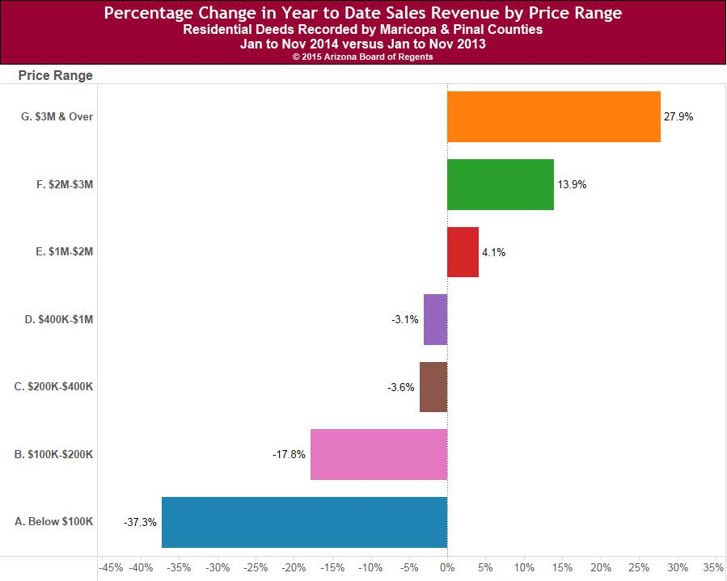

Slide 12
what and where
Demand WEAK for homes to buy
Demand STRONG for homes to rent
Demand remains STRONG for very high-end luxury homes
technology
  Smart Homes emerge – technological disruption and consumer demand for connected places important
  Technology pushing change in space use
  E-commerce and crowdfunding being viewed as an adaptation challenge
    “Omnichannel distribution" and “e-tailers” to open brick-and-mortar stores – changes where and how we do things

Slide 13
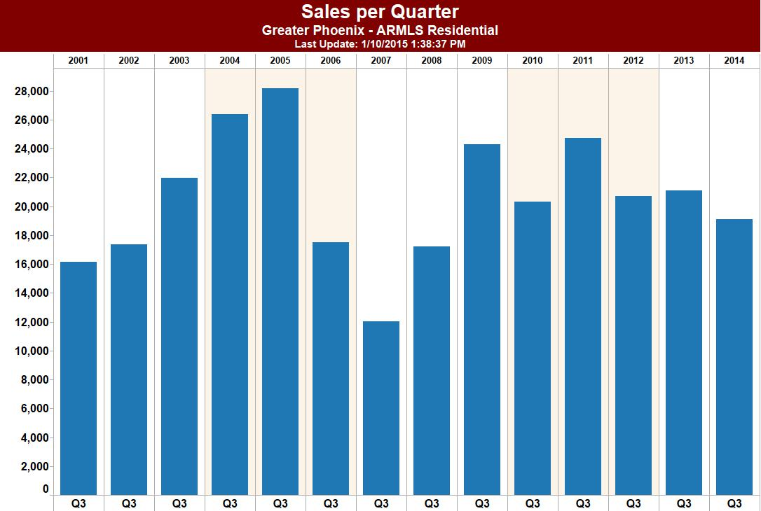

Slide 14
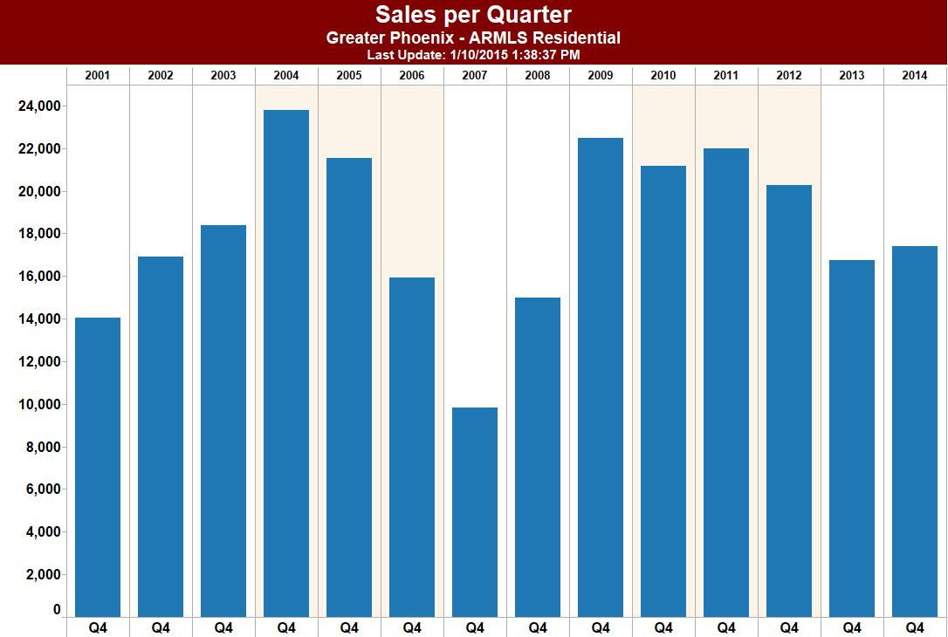

Slide 15
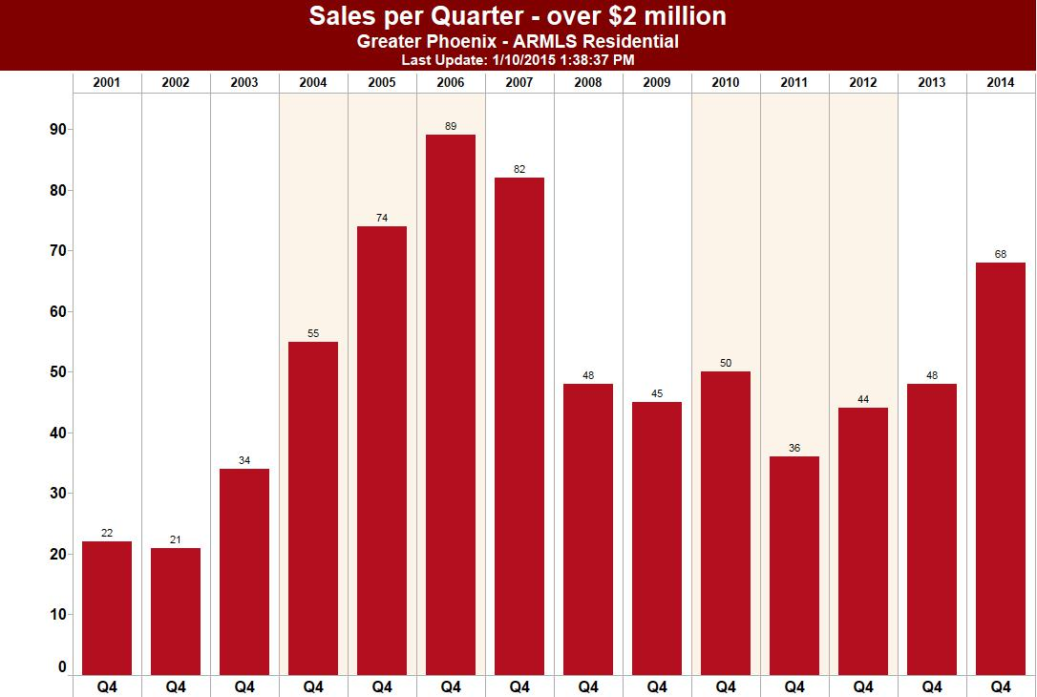

Slide 16
Why is Demand Weak?
  Investor purchases dropped 41% in 2014 from 2013.
  Owner/occupier purchases rose 0.3%.
  Millennials are not buying homes like their parents did.
    Far more living with parents, sharing or renting
  1 in 4 former owners are in “The Penalty Box.”
    367,000 owners lost homes to foreclosure/short sale
  Large lenders are still very risk-averse.
    Avg. FICO for DENIED Conventional Purchase Loan = 722
    Avg. FICO for CLOSED Loan = 754
  Income and wealth disparity is increasing.
  Very slow income growth (0.9% for Phoenix 2011-2013)

Slide 17


Slide 18
Millennial Impact on
Housing Market
  Starting families later than earlier generations
  Lower birth rates
  Many still living with parents
  Higher preference for urban lifestyle
  Tendency to share accommodation & transport
  Not convinced home ownership is good for wealth
  Expect to own a home…one day
  Not a high priority for them in 2015
  Mostly renting – creating demand for landlords

Slide 19
Prediction is very difficult, especially about the future.
─ Neils Bohr (1885-1962)

Slide 20
what and where
Mortgage Rates
Mortgage rates—even initial rates on adjustable-rate loans—will grind higher in 2014, says McBride. Kiplinger’s expects the 30-year fixed-rate mortgage, recently just over 4.4%, to rise to 5% or 5.5% by year-end.
[April 2014]
technology
  Smart Homes emerge – technological disruption and consumer demand for connected places important
  Technology pushing change in space use
  E-commerce and crowdfunding being viewed as an adaptation challenge
    “Omnichannel distribution" and “e-tailers” to open brick-and-mortar stores – changes where and how we do things
Fannie Mae forecasts the 30-year fixed-rate mortgage will reach 5% by year-end. [January 2014]
National Association of Realtors forecasts the 30-year fixed-rate mortgage will reach 5.3% by year-end. [January 2014]
The Mortgage Bankers Association forecasts the 30-year fixed-rate mortgage will reach 5.3% by year-end. [January 2014]
Several prominent pundits stated these forecasts were too timid and that rates would reach 5.75% to 6% by year-end. [February 2014]

Slide 21
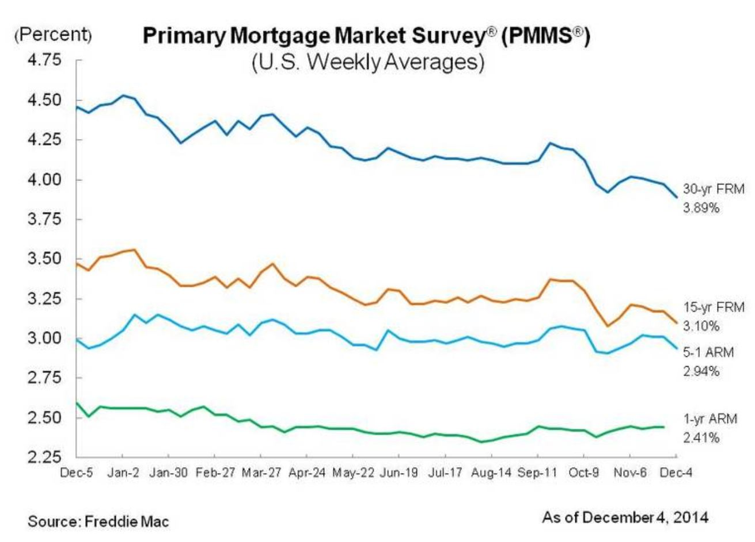

Slide 22
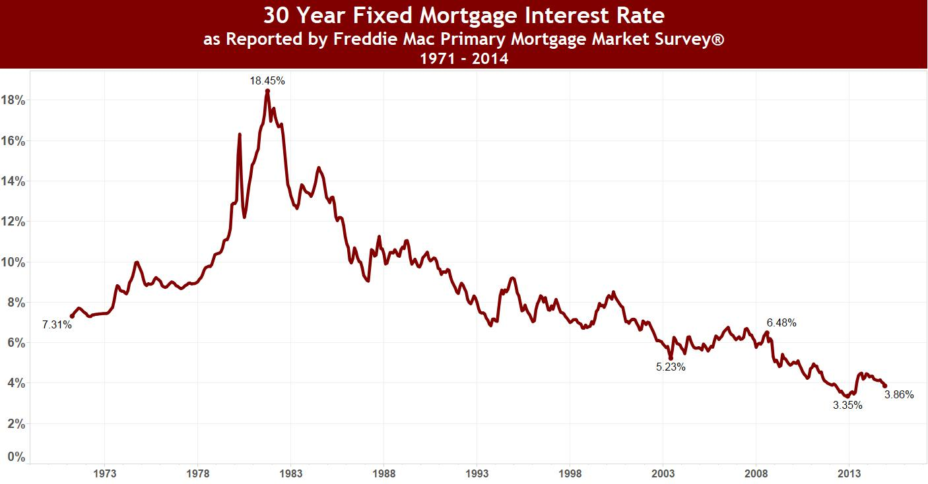

Slide 23
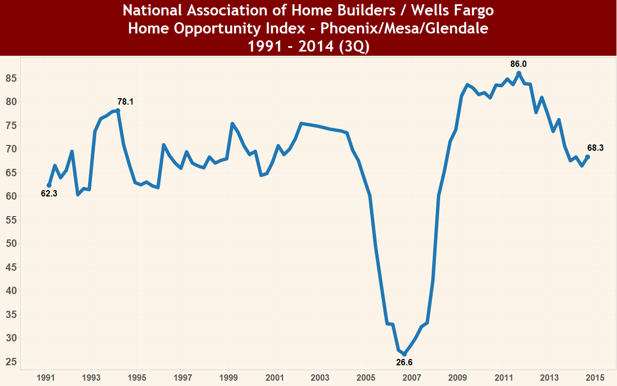
NORMAL ZONE
HOI = the percentage of homes sold in a quarter that are affordable to a family earning the median income

Slide 24
Home Opportunity Index
3Q 2014 National HOI = 61.8
Detroit, MI 78.4
Tucson, AZ 75.9
Albuquerque, NM 71.4
Atlanta, GA 70.3
Phoenix, AZ 68.3
Salt Lake City, UT 65.9
Las Vegas, NV 64.7
Denver, CO 64.5
Austin, TX 61.2
Dallas, TX 55.0
Portland, OR 53.1
Seattle, WA 49.6
Boston, MA 46.8
Riverside, CA 45.6
Miami, FL 47.7
Honolulu, HI 38.3
Santa Barbara, CA 37.0
Santa Rosa, CA 25.6
San Diego, CA 23.4
New York, NY 21.6
San Jose, CA 20.9
Los Angeles, CA 16.3
Santa Cruz, CA 14.8
San Francisco, CA 11.4

Slide 25
Home Opportunity Index
3Q 2014 National HOI = 61.8
Phoenix, AZ
68.3
Median Home
$200,000
Median Income
$61,900
National Rank
137 of 227
National Rank in 2011
51 of 227
San Jose, CA
20.9
Median Home
$689,000
Median Income
$101,900
National Rank
221 of 227
National Rank in 2011
217 of 227

Slide 26
Single-Family Rentals
  Investors are pulling back, but tenants are still coming.
  Only 3,001 single-family rental listings are on ARMLS.
  4,353 last year
  Rents are climbing.
  Most of what is left is expensive (avg. $1,746 per month).
  Average in January 2014 was $1,449 per month.
  Supply in the $900 to $1,200 range is down 40%.
  Supply over $2,000 is up 6%.

Slide 27
Situation Summary – Jan. 2015
  Supply is well below normal (84% of normal).
  Demand is weak, but growing (83% of normal).
  AZ loan delinquency is below normal at 4.5%.
  New foreclosures are at their lowest level in 15 years.
  Lending rules are starting to loosen.
  Millennials are starting to have children.
  Rent-vs.-buy analysis strongly favors buying.
  The economy and jobs continue to improve.
  Time to change from relief to optimism.

Slide 28
Outlook
  Both demand and supply will grow in the near term.
  Supply of homes for sale is growing slower than demand.
  Supply of affordable homes for rent is growing slower than demand.
  Supply of expensive homes for rent is growing faster than demand.
  Rental rates will continue to increase in most areas.
  Resale and new-home pricing may regain a little upward momentum.
  Household formation is starting to accelerate from its weak level.
  Luxury market will continue to outperform, if the stock market does well.
  Whole market will improve as lending standards are gradually loosened.

Slide 29

Connect with W. P. Carey School
Mark Stapp
Fred E. Taylor Professor of Real Estate
Executive Director Master of Real Estate Development,
W. P. Carey School of Business
mark.stapp@asu.edu
/wpcareyschool
@wpcareyschool
Michael Orr
Director of Center for Real Estate Theory and Practice,
W. P. Carey School of Business
mike.orr@asu.edu
/wpcareyschool
8
wpcarey.asu.edu
www.wpcarey.asu.edu
research.wpcarey.asu.edu

